Slide 1


Asynchronous Operations
Celery and Redis
SoftUni Team
Technical Trainers
Software University
https://softuni.org

Slide 2
Have a Question?
Channel for Communication

Slide 3
Table of Contents
Asynchronous Operations
Celery
Task / Job Queues
Scheduling
Redis
Message Broker
Application with Celery and Redis - Live Demo
3
Notes:
3

Slide 4

Asynchronous Operations

Slide 5
What is an Asynchronous Operation?
An Asynchronous Operation is a computation or task that doesn't block the main thread of execution, allowing other operations to proceed concurrently
The operation runs independently of the main program flow, enabling parallelism and non-blocking behavior
Once an asynchronous operation is initiated, the program can continue with other tasks before the operation completes

Slide 6
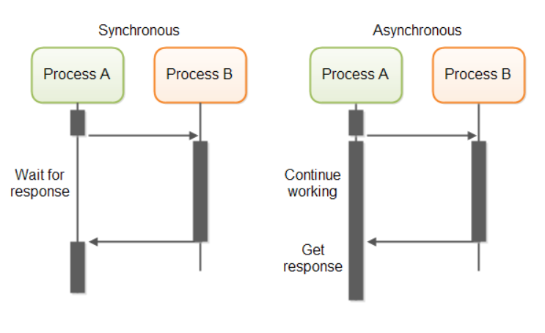
Synchronous vs. Asynchronous
When you execute something synchronously, you must wait for it to complete before proceeding to the next task

Slide 7
Advantages
With asynchronous execution, you initiate a routine and allow it to run in the background while starting subsequent tasks
At some point, you may need to synchronize and wait for specific operations to finish
The asynchronous model enables concurrent execution of multiple tasks
While A is still running, you can execute B, C, or D, maximizing resource utilization and reducing wait times
A -> B -> C -> D

Slide 8
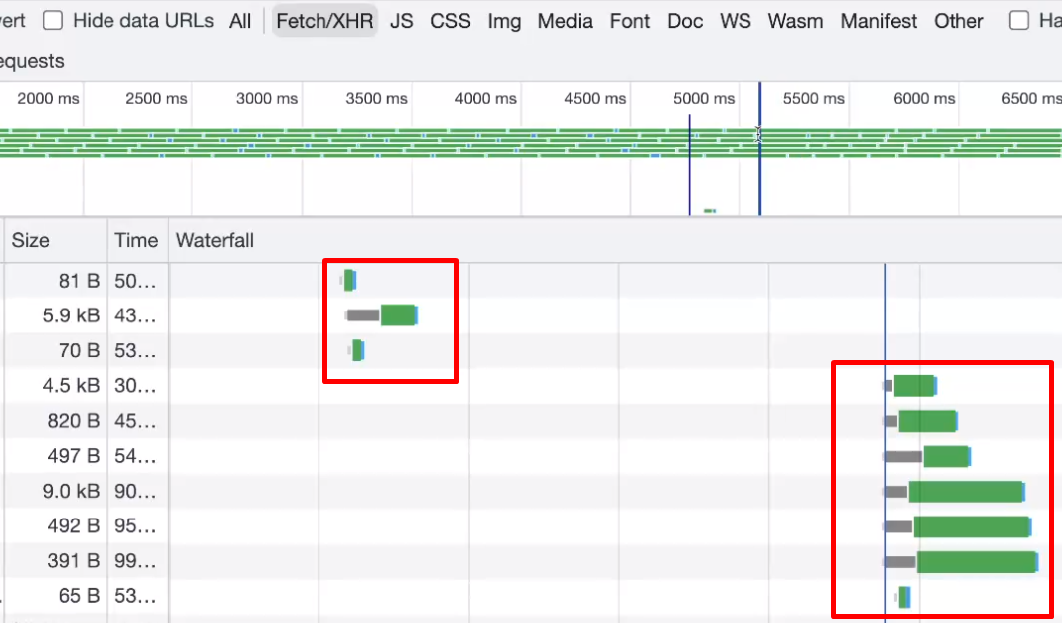
Asynchronous Operations
When accessing a modern website, some of its resources are typically loaded asynchronously
This approach improves loading times and enhances user experience

Slide 9
Asynchronous Operations - Simple Example
import asyncio
async def do_work():
print("Working...")
await asyncio.sleep(1) # Simulates an asynchronous operation that takes 1 second
print("Work done!")
async def main():
print("Before asynchronous operation")
asyncio.create_task(do_work()) # Starts the asynchronous operation concurrently
print("Doing something else while waiting...")
await asyncio.sleep(0.5) # Simulates doing something else for 0.5 seconds
print("Continuing with main operation")
await asyncio.sleep(0.5) # Simulates more work after the asynchronous operation completes
print("After asynchronous operation")
asyncio.run(main())

Slide 10
Celery

Slide 11

What is Celery?
Celery is a distributed task/job queue that facilitates asynchronous processing through distributed message passing
It is designed to handle large-scale, asynchronous tasks efficiently, allowing for parallel execution across multiple workers

Slide 12
What is Celery?
Celery also provides support for task scheduling, enabling the execution of tasks at predefined intervals or specific times
This combination of real-time operation and scheduling capabilities makes Celery a versatile tool for various asynchronous workload scenarios

Slide 13
Celery's Task Scheduling Capabilities
Consider the scenarios where you've needed to execute tasks at specific future times
Whether accessing an API hourly or sending a batch of emails daily
Celery simplifies scheduling such periodic tasks, regardless of their scale
By efficiently managing asynchronous operations, Celery ensures that end users never experience unnecessary delays in page loading or task completion

Slide 14

Redis

Slide 15
What is Redis?
Redis is an advanced in-memory data structure store that serves as a distributed, in-memory key-value database
Optionally supporting durability through various persistence mechanisms
It excels in providing lightning-fast data access by storing datasets entirely in RAM
Making it ideal for use cases where high performance and scalability are paramount

Slide 16
Why Use Redis?
Among its diverse range of applications, Redis is commonly employed for session caching, enabling fast and efficient storage and retrieval of user session data
Additionally, it serves as a robust full-page cache solution, dramatically improving website performance by storing rendered pages in memory for rapid delivery to users

Slide 17
Redis as a Message Broker
Redis also serves as a powerful message queue system, facilitating the asynchronous processing of tasks in a distributed environment
Its efficient publish-subscribe functionality enables real-time messaging and event-driven architectures
Overall, Redis can be utilized as a message broker in building scalable and responsive applications

Slide 18

Live Demo
Creating an Image Thumbnailer App

Slide 19
Installing Packages
Start a new Django project image_parroter and create an app thumbnailer
Install Celery and Widget tweaks, add them to the installed apps
pip install celery pillow redis django-widget-tweaks eventlet
pip freeze > requirements.txt
Install all packages at once
# settings.py
INSTALLED_APPS = [
…
'widget_tweaks',
'celery',
'thumbnailer',
]

Slide 20
Celery Settings
Celery settings in settings.py
Try Redis Cloud at https://redis.com/try-free/
Optionally, you can use Redis locally
# settings.py
...
# Celery
# CELERY_BROKER_URL = 'redis://127.0.0.1:6379' # Locally
CELERY_BROKER_URL = 'redis:// default:*******@redis-14500.c328.europe-west3-1.gce.cloud.redislabs.com:14500' # Redis Cloud
CELERY_RESULT_BACKEND = 'redis:// default:*******@redis-14500.c328.europe-west3-1.gce.cloud.redislabs.com:14500' # Redis Cloud
CELERY_ACCEPT_CONTENT = ['application/json']
CELERY_RESULT_SERIALIZER = 'json'
CELERY_TASK_SERIALIZER = 'json'
CELERY_TIMEZONE = 'Europe/Sofia'
Define a broker (Redis, RabbitMQ, etc.)
Your Redis URL
Optional settings

Slide 21
Celery Settings
To integrate Celery, create a new file celery.py
# image_parroter/celery.py
import os
from celery import Celery
from django.conf import settings
os.environ.setdefault('DJANGO_SETTINGS_MODULE', 'image_parroter.settings')
celery_app = Celery('image_parroter')
celery_app.config_from_object('django.conf:settings', namespace='CELERY')
celery_app.autodiscover_tasks(lambda: settings.INSTALLED_APPS)

Slide 22
Injecting Celery into Django
To ensure that the celery application gets injected into the Django application, import it within the Django project's main __init__.py script
# image_parroter/__init__.py
from .celery import celery_app
__all__ = ('celery_app',)

Slide 23
Starting a Celery Worker
Use the celery command to start a Celery worker
Replace image_parroter with the name of your Django project containing the Celery app in case it is different
celery -A image_parroter worker --loglevel=info -P eventlet -E

Slide 24
Tasks
Create tasks.py within the "thumbnailer" application
Inside the tasks.py file import the shared_tasks function decorator and use it to define a celery task function called add_test
# thumbnailer/tasks.py
from celery import shared_task
@shared_task
def add_test(x, y):
return x + y
A simple task to test the Celery and Redis configurations

Slide 25
Creating Image Thumbnails
Back in the tasks.py file import the Image class from the PIL package
Add a new task called make_thumbnails
It should accept an image file path and a list of 2-tuple width and height dimensions to create thumbnails from

Slide 26
Creating Image Thumbnails
# thumbnailer/tasks.py
import os
from zipfile import ZipFile
from celery import shared_task
from PIL import Image
from django.conf import settings
@shared_task
def make_thumbnails(file_path, thumbnails=None):
os.chdir(settings.IMAGES_DIR)
path, file = os.path.split(file_path)
file_name, ext = os.path.splitext(file)
zip_file = f"{file_name}.zip"
results = {'archive_path': f"{settings.MEDIA_URL}images/{zip_file}"}
# Continues on the next slide
Defining the Celery task
Setting the zip file name
Setting the zip path

Slide 27
Creating Image Thumbnails
...
try:
img = Image.open(file_path)
zipper = ZipFile(zip_file, 'w')
zipper.write(file)
os.remove(file_path)
for w, h in thumbnails:
img_copy = img.copy()
img_copy.thumbnail((w, h))
thumbnail_file = f'{file_name}_{w}x{h}.{ext}'
img_copy.save(thumbnail_file)
zipper.write(thumbnail_file)
os.remove(thumbnail_file)
img.close()
zipper.close()
except IOError as e:
print(e)
return results
Generating the zip file
Exception Handling

Slide 28
Setup Media Root and Media URL
Set a MEDIA_ROOT location where image files and zip archives can reside, specify the MEDIA_URL where the content can be served from
# settings.py
STATIC_URL = '/static/'
MEDIA_URL = '/media/'
MEDIA_ROOT = os.path.abspath(os.path.join(BASE_DIR, 'media'))
IMAGES_DIR = os.path.join(MEDIA_ROOT, 'images')
if not os.path.exists(MEDIA_ROOT) or not os.path.exists(IMAGES_DIR):
os.makedirs(IMAGES_DIR)

Slide 29
Creating the Views
# thumbnailer/views.py
import os
from celery import current_app
from django import forms
from django.conf import settings
from django.http import JsonResponse
from django.shortcuts import render
from django.views import View
from .tasks import make_thumbnails
class FileUploadForm(forms.Form):
image_file = forms.ImageField(required=True)
# Continues on the next slide
Creating the form

Slide 30
Creating the Views
class HomeView(View):
def get(self, request):
form = FileUploadForm()
return render(request, 'home.html', { 'form': form })
def post(self, request):
form = FileUploadForm(request.POST, request.FILES)
context = {}
if form.is_valid():
file_path = os.path.join(settings.IMAGES_DIR, request.FILES['image_file'].name)
with open(file_path, 'wb+') as fp:
for chunk in request.FILES['image_file']:
fp.write(chunk)
task = make_thumbnails.delay(file_path, thumbnails=[(128, 128)])
context['task_id'] = task.id
context['task_status'] = task.status
return render(request, 'home.html', context)
context['form'] = form
return render(request, 'home.html', context)
Generating an empty form
Defining the behavior upon POST request
Saving the submitted file
Generating the Celery task using the delay() method

Slide 31
Creating the Views
class TaskView(View):
def get(self, request, task_id):
task = current_app.AsyncResult(task_id)
response_data = {
'task_status': task.status,
'task_id': task.id
}
if task.status == 'SUCCESS':
response_data['results'] = task.get()
return JsonResponse(response_data)
The view takes the task id and visualizes the task data in JSON format

Slide 32
Adding the URLs
Add a urls.py file in the thumbnailer application and define the following URLs
# thumbnailer/urls.py
from django.urls import path
from . import views
urlpatterns = [
path('', views.HomeView.as_view(), name='home'),
path('task/<str:task_id>/', views.TaskView.as_view(), name='task'),
]

Slide 33
Modifying the Main URLs
Modify the main URLs
# urls.py
from django.contrib import admin
from django.urls import path, include
from django.conf import settings
from django.conf.urls.static import static
urlpatterns = [
path('admin/', admin.site.urls),
path('', include('image_parroter.thumbnailer.urls'))
] + static(settings.MEDIA_URL, document_root=settings.MEDIA_ROOT)

Slide 34
Creating the Template
Next, create a simple template so the user can submit an image file
The user should be able to:
Check the status of the submitted make_thumbnails tasks
Initiate a download of the resulting thumbnails
You are provided with the HTML file as a resource
Test your application at http://localhost:8000

Slide 35
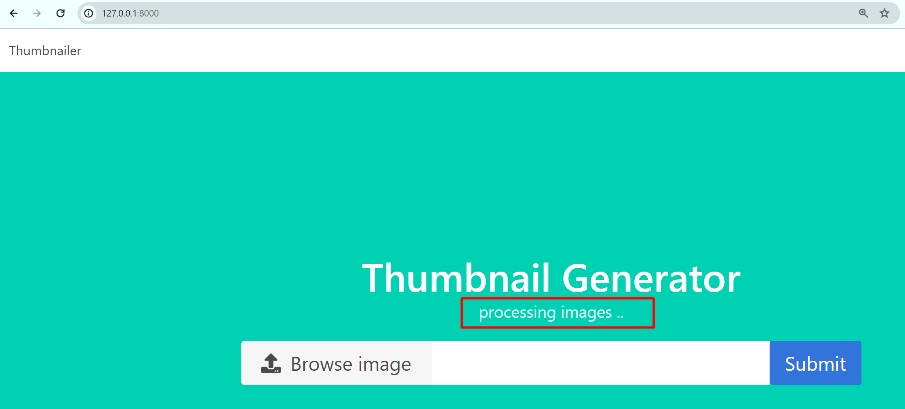
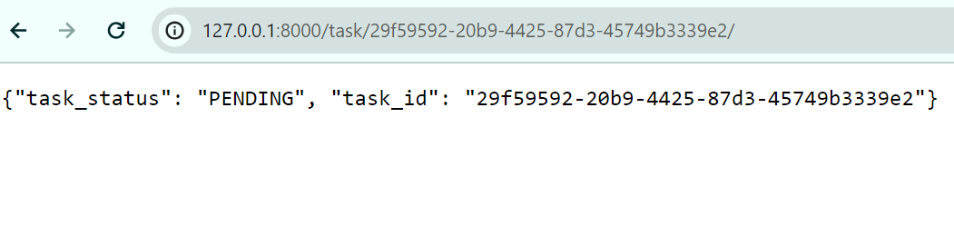
Thumbnailer Tasks

Slide 36
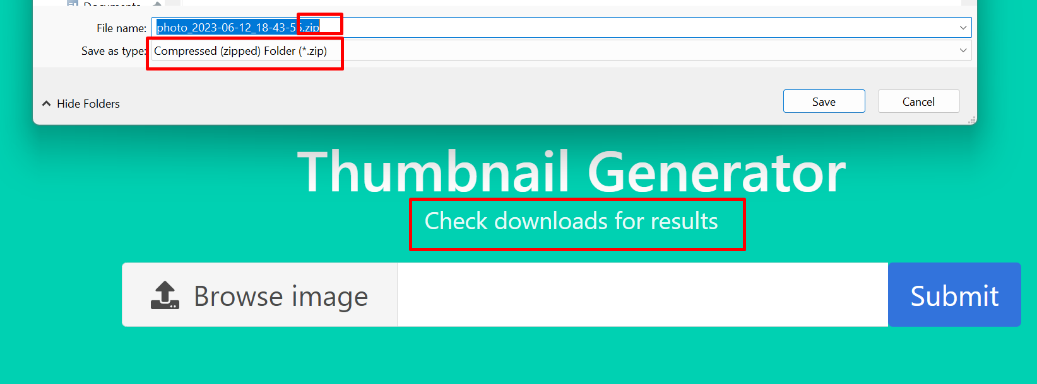
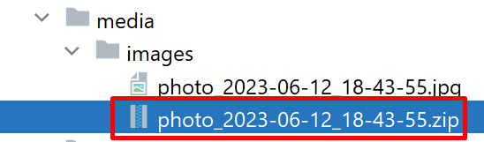
Thumbnailer Tasks

Slide 37

Summary
Asynchronous Operations
Celery
Job Queue
Scheduling
Redis
Message Broker
Notes:
37

Slide 38









Questions?

Slide 39












SoftUni Diamond Partners

Slide 40
Trainings @ Software University (SoftUni)
Software University – High-Quality Education, Profession and Job for Software Developers
softuni.bg
Software University @ Facebook
facebook.com/SoftwareUniversity
SoftUni Global
softuni.org
40
Notes:
40

Slide 41

License
This course (slides, examples, demos, exercises, homework, documents, videos and other assets) is copyrighted content
Unauthorized copy, reproduction or use is illegal
© SoftUni – https://about.softuni.bg/
© Software University – https://softuni.bg
© SoftUni Global – https://softuni.org
Notes:
41

